Slide 1
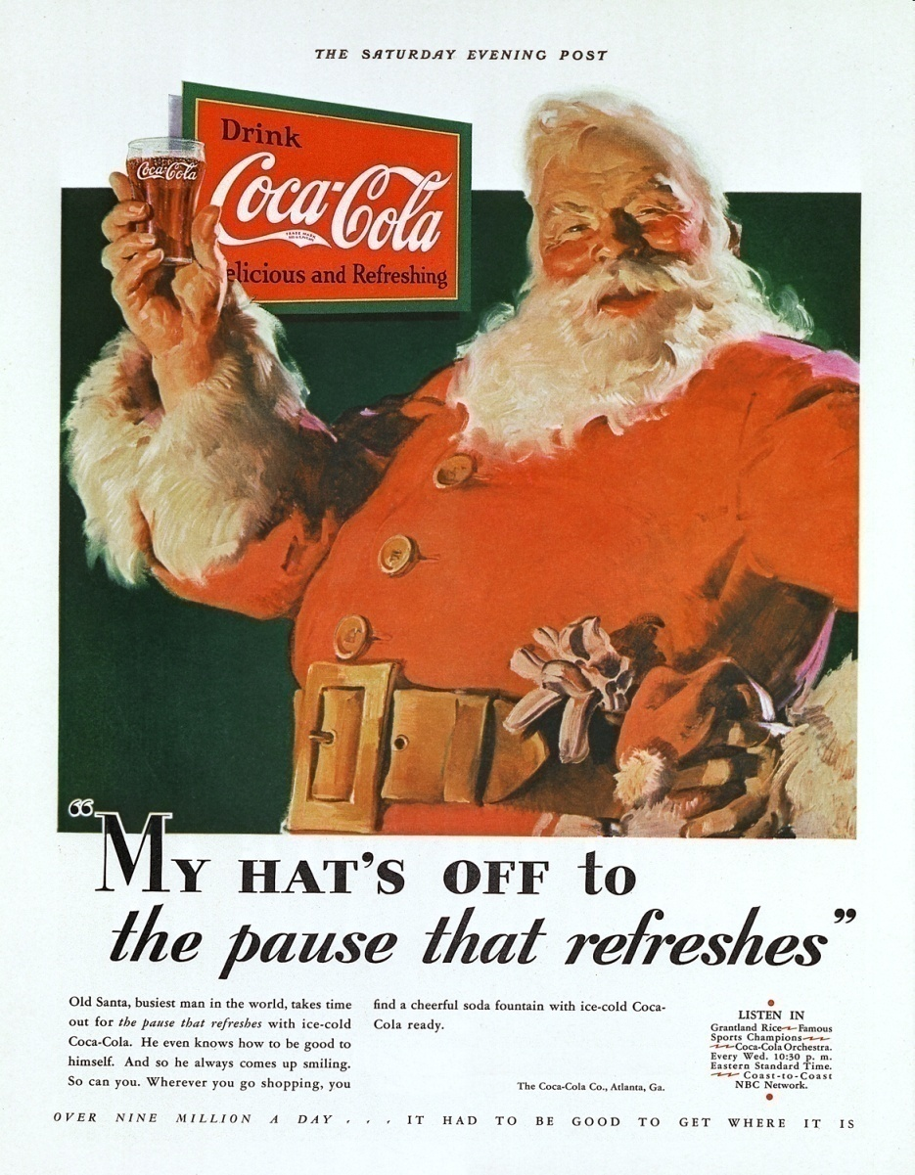
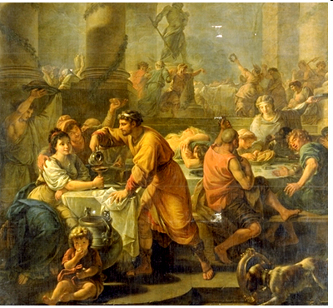
Celebrating Christmas:
Why, Who and How?
David Kyle Johnson
Assoc. Prof of Philosophy King’s College

Slide 3
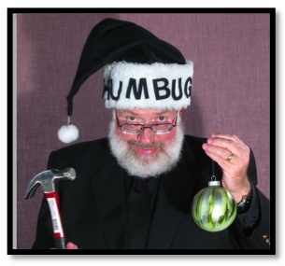
My Thesis
Atheist Tom Flynn, in his book The Trouble with Christmas argues that non-Christians shouldn’t celebrate Christmas.
By celebrating around Christmas, he argues, humanists tacitly participate in Christian rituals, add legitimacy to Christianity, and lose the ability to criticize the religion.
How can you not like Christianity, or think it is a bad thing, if you celebrate Christmas—the biggest Christian holiday?
He doesn’t celebrate and even goes to work on Christmas day. (He gets a lot done; no one else is there.)
I am going to disagree with him on a fundamental level.
I will argue that humanists and non-Christians have
every right to celebrate during the holidays (including
HumanLight), and even to wish (and be wished) a
“Merry Christmas.” There is nothing wrong with
doing so!
In fact, to not do so for the reasons Flynn mentions is
to grant Christians a victory that they have sought for
hundreds of years but never achieved—a victory in
their “War for Christmas.”
Tom Flynn

Slide 4
The Myth
It all started with the birth of Jesus 2000 years ago, in year zero, with “The First Noel”—that is, the first Christmas. And we have been celebrating his birth with church services and charity ever since. Inspired by the Wise Men, we began to give each other gifts in honor of the gentle infant baby Jesus. Later, St. Nicholas made a habit of giving gifts to children, and once he died parents continued to give gifts in his name. Unfortunately, thanks to seculars and their war on Christmas, the holiday has become diluted. They turned the Saint into the secular Santa Claus and made the holiday all about presents, consumerism and raucous parties, and left the baby Jesus behind. But we should all remember that Jesus is the reason for the season and to keep Christ in Christmas!

Slide 5
My Method
To defend my thesis I am going to do three things:
Present an early history of Christmas.
Show how and why Christmas reemerged as a major holiday during the 1800s.
Reveal why this entails that Christmas is not a Christian holiday, that Christians have no rightful claim on it or to dictate how it “should” be celebrated, and thus that celebrating it in no way endorses Christianity.
I will close with some suggestions for celebration.

Slide 6
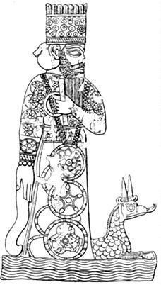
THAT was NOT the first Noel: Pre-Christian December Holidays
4000 BCE: Mesopotamia: Zagmuk
Marduck and “King for a day” (with execution)
4000 BCE: Persia and Babylon: Sacaea
Feasting, Mock King (with execution), Social Inversion
500 BCE: Roman Republic: Saturnalia
Social inversion, Mock King (no execution), feasting,
drinking, small gifts, orgies.
Saturn proclaimed: “Let every man be treated
equal, slave and freeman, poor or rich…no one
may be ill-tempered…all shall drink the same
wine…have their meat on equal terms…when a rich
man gives a banquet to his servants, his friends
shall aid him in waiting on them.” (Forbes p. 8-9)
500 BCE: Scandinavia: Yule (Jul)
Feasting, evergreen, Odin and Thor
Marduck

Slide 7
Saturnalia

Slide 8
Saturnalia

Slide 9
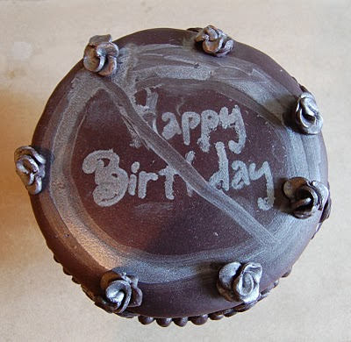
Early Christianity
Saturnalia was a popular December celebration in the Roman Empire.
Jesus would have been born between 15 BCE and 15 CE.
Earliest writings (Paul and Mark) mention nothing about Jesus’ birth.
Luke and Matthew wanted to establish Jesus’ “status” at birth, but their birth stories are different and contradictory.
Other additions to the story were made by pseudo-gospels—e.g., virgin birth and perpetual virginity.
Early Christians (first 350years) did not
celebrate birthdays (like pagans do) and
thus did not celebrate Jesus’ birth.
But two gospels – Mathew and Luke—do
tell the story, to establish that he was
“special from birth.”

Slide 10
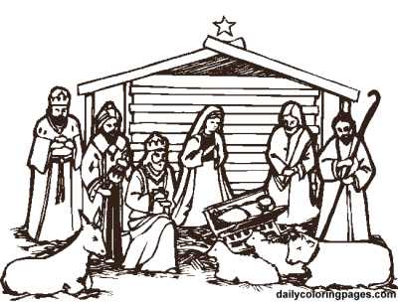
The Nativity Stories - Differences
Matthew: Herod, wise-men, slaughter of innocents, star, angel appears to Joseph.
Luke: angel appears to Mary, census, shepherds, host of angels, inn and manger, temple presentation.

Slide 11
The Nativity Stories - Contradictions
Location:
Matthew’s story starts in Bethlehem (they live there), the family flees to Egypt because of Herod’s threat, then they move to Nazareth.
Luke’s story starts in Nazareth (they live there), they have to go to Bethlehem for a census, then they go right back to Nazareth after a quick stop at the temple in Jerusalem.
Time period:
Matthew has Herod ruling (he died in 4 BCE).
Luke specifically places the precursors of the story (the heralding of the birth of John the Baptist) during the days of Herod’s reign, but then specifically places all other events “after those days.” Even more specifically, Luke says the birth takes places while Quirinius is governor of Syria (he began his rule as governor of Syria in 6 CE).
Both knew nothing of Jesus’ birth, but were simply telling a story consistent with what they knew from Mark (born in Bethlehem, from Nazareth, mother is Mary). But they told totally different stories that had these elements.

Slide 13
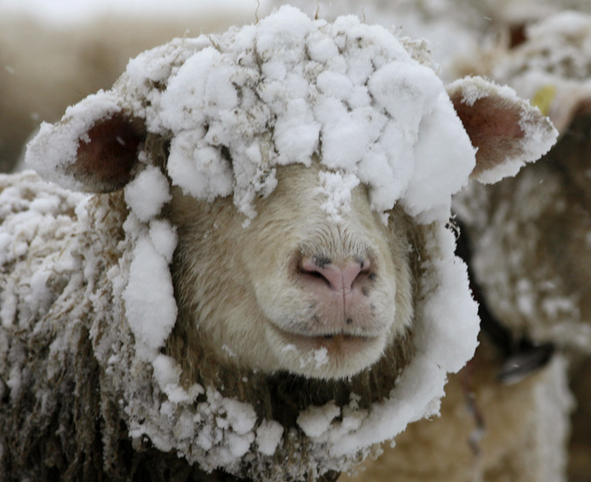
The Nativity Stories – Other Problems
No census ever required relocation, much less one based on ancestral relations tracing back 1000 years.
No record of a census under Caesar Augustus.
No record of a slaughter of innocents by Herod in Bethlehem—and careful records were kept.
A star that “leads” and stops over a specific house doesn’t make any sense.
Also note: The magi would not have arrived until at least 2 years after Jesus’ birth, not “in the stable.”
Mathew’s Virginal Conception is based in a mistranslation of Isaiah 7:14. (“young woman” vs. “virgin”)
Note: Nothing about virginity in Mark,
the earliest gospel.
There is no way shepherds would watch
their flocks by night, at the end of
December, when the days were
shortest.

Slide 14
In other words….
A billboard on display close to the Lincoln Tunnel in 2010

Slide 15
The War for Christmas Begins
Constantine “converted” to Christianity in the early 300s.
The biggest festivals and celebrations: Saturnalia (mid-December) and the sun god’s (Sol/Mithra) birthday—Dec 25th (their solstice).
Sun god was big with the military and government officials.
Constantine “declared” Dec 25th Jesus’ birthday to aid in the conversion of his empire. (He couldn’t convert his empire or army by force, but he couldn’t have them celebrating non-Christian festivals either.)
This way, he could say, the celebration was done “in Jesus’ name.”
Around 336, Dec 25th is first identified, in print, as the anniversary of Jesus’ birth.
So starts the effort to “Christianize” December celebrations.
People begin to forget the real origin of the celebration.

Slide 16
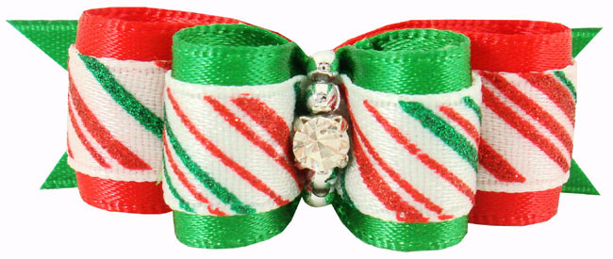
Why Think Constantine was Motivated by Conversion?
The similar date can’t be coincidence.
He had to either eliminate everyone’s favorite holiday, Saturnalia, or Christianize it.
There is evidence that Christians before Constantine were already trying to gain legitimacy and converts by making Christ like Sol Invictus, the sun god.
Aurelian had declared sun worship the official Roman religion around 270, to unify the empire and to combat Christianity.
Evidence suggests a propaganda war ensued: Pope Leo complained that Christians were still bowing to the sun before entering St. Peter’s Basilica as late as the mid 400s.
Moved their Sabbath from Saturday to Sunday .
Artwork depicted Jesus riding the “sun chariot” across the skies from late 300s (similarity continues today).

Slide 17
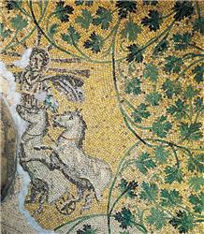
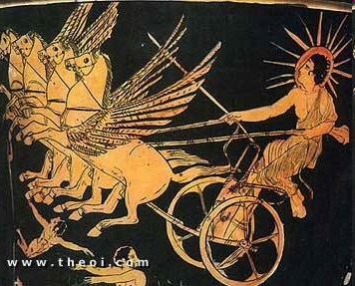
Sol Invictus
Jesus

Slide 18
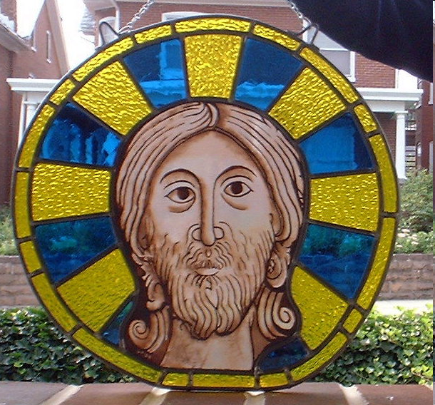
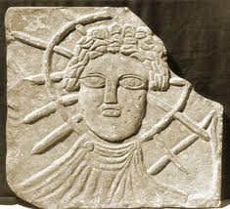
Sol Invictus
Jesus

Slide 19
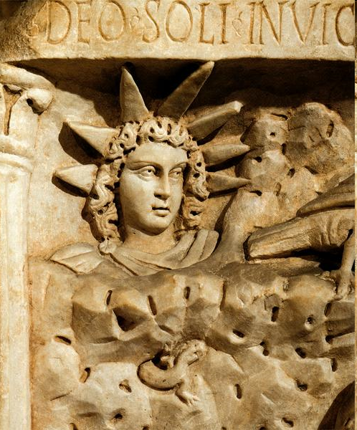
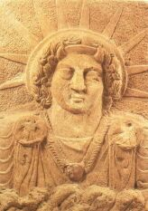
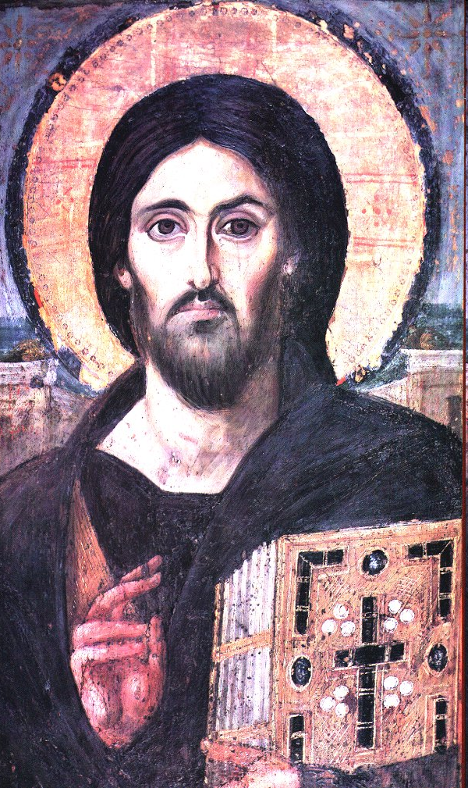
Sol Invictus
?
Jesus

Slide 20
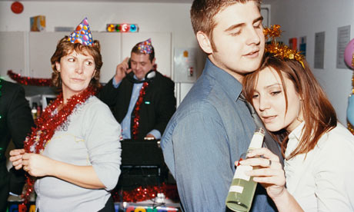
Christianizing Christmas
It’s important to realize that these efforts were part of a campaign to claim late December holidays for Christ—to make people think that the holiday originated from Christianity and ultimately to Christianize the holiday.
Some of these efforts were successful…
Most people did eventually forget the origins of the holiday, and assumed that it began in year one with the birth of Christ. (This is evident still today.)
… and others were not.
The holiday was never Christianized.
The reason that Constantine had to “re-label” the holiday, instead of eliminate it, is because he couldn’t. People weren’t going to stop celebrating their favorite holiday, and they weren’t going to change the way they did. (Can you imagine if the president declared that we all stop buying Christmas gifts?)
The raucous customs of misrule, social inversion, heavy drinking and wild sex continued…to this day.

Slide 21
Christmas in the Middle Ages
The church tried to tone things down…
It did exciting things like added a midnight mass, and then a morning mass…and a sunrise mass…and an evening mass. (Are we trying to keep people away from parties?) Advent, Epiphany, etc….But it never worked.
Some good Christians bookended their midnight mass with orgies. (This tradition continued as late as the 1820s in Ireland.)
Complaints were made to the Pope about the heathen celebrations of Christians at Christmas, particularly in Rome.
And it didn’t help that, as it rolled through Europe, it found and assimilated (again for conversion purposes) other pagan December celebrations that were just as raucous—like the Norse Jul.
Midnight mass was called “Christ’s mass,” and the name eventually stuck for the holiday around 1100s.
Interestingly, this is around the same time that French nuns first secretly delivered presents on the death anniversary of a saint named Nicholas.
… but it never really succeed.

Slide 22
The Puritans and Christmas
The effort to Christianize the holiday was such a failure that the Puritans surrendered; they ended the Christian War for Christmas by declaring a War on Christmas. Knowing that it was rooted in pagan religion, and hating it’s raucousness, Puritans banned the celebration of Christmas.
You had to work on Christmas—couldn’t take the day off.
You couldn’t go to church on Christmas (unless it fell on a Sunday).
They (e.g., Increase Mather, Cotton Mather) preached against its evils.
You could be fined, or put in the stocks, for celebrating.
They didn’t control everything, but celebrating Christmas remained very unpopular through the 1600s and into the 1800s—both in Europe and the American Colonies.
It wasn’t even a nationally recognized holiday until 1870.

Slide 23
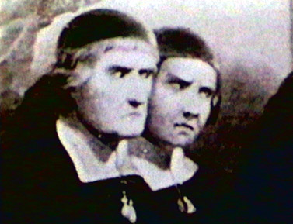
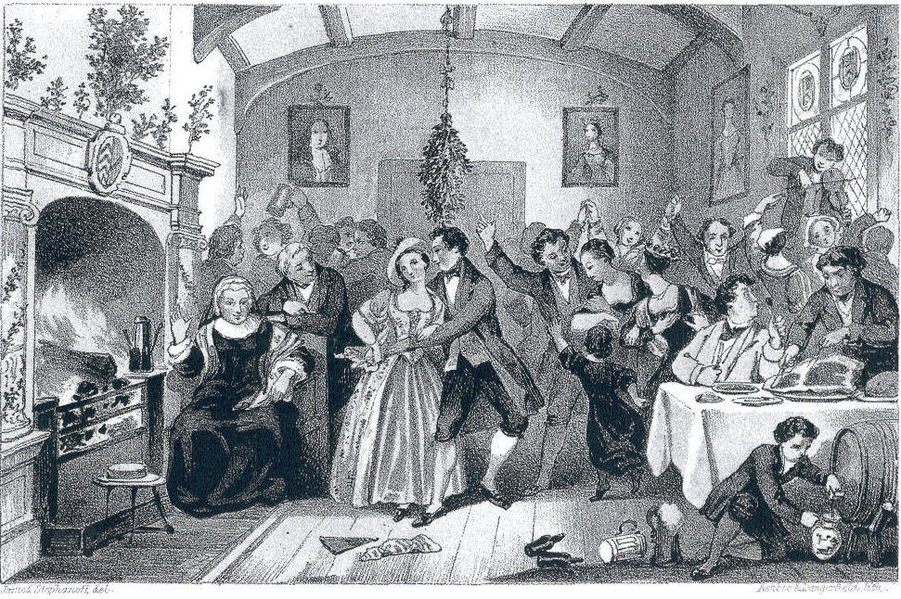
Some staunch puritans…
…look disapprovingly at a raucous Christmas celebration

Slide 24
The Christmas Comeback (early 1800s)
As Puritan influence decreased, interest in Christmas increased.
But the revived traditions were not Christian.
Feasting, Drinking and Sex
Wassailing
Mumming/Begging
Freedom of Slaves in Antebellum South during Christmas.
All served as a social safety valve.

Slide 25
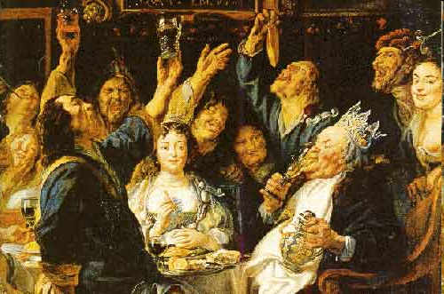
Wassailing!

Slide 26
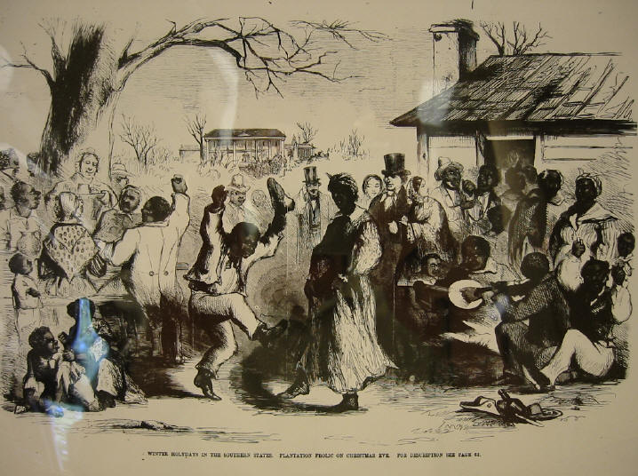
Antebellum Slave Christmas Celebrations

Slide 27
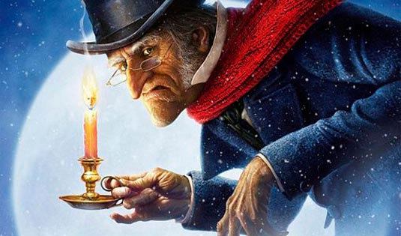
A Christmas Carol
Charles Dickens's famous tale plays a huge role in reviving the holiday.
Important notes:
The story has no religious elements.
Most people were like Scrooge—open for business on Christmas (like the butcher who had the turkey).
Scrooge is not rich—he owns a meager business with one employee.
Bob Cratchit is not poor—he has an office, his wife doesn’t work, he is not a factory worker or coal miner.
It is a story about how to deal, at Christmas, with those just under you in your own social class. But everyone has claimed it for themselves.
The popularity of the story popularizes the holiday.

Slide 28
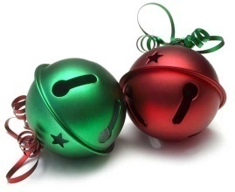
A Visit from St. Nicholas
As industrialization increased, and capitalism widened the gap between rich and poor, the revived Christmas traditions of inversion (like wassailing) became a form of protest.
The rich—like Clark Clement Moore—feared vandalism, theft, and worse. “Oh, how to change Christmas?”
He found his answer in a poem that was probably written by Henry Livingston Jr.
It told the story of a nervous rich man, worried about Wassailers, but who only found St. Nicholas delivering gifts.
Most elements of the story were invented, or borrowed from the PA German Belsnickel tradition.
It depicted the holiday as a domestic, child centered, affair.
The rich published the story everywhere they could. Moore published it with “his writings” (many plagiarized) under his name.
Soon people, even the poor, were tricking their children into believing that Santa brought their kids presents—instead of trying to get into rich people’s houses.

Slide 29
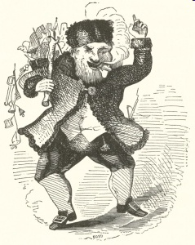
The first depiction of St. Nick to go with Moore’s poem.
sacred-texts.com

Slide 30
Make Room for The Presents!
Although small gifts had always been a part of December celebrations, they had never been the focus.
But the Santa tradition changed that; gifts for kids were THE FOCUS of the holiday now.
Businesses soon had “must have” presents.
Santa set up headquarters at
local shops.
Business convinced us that we
were obligated to buy gifts for
everyone we knew (not just kids).
Worthless products, just to give
out at Christmas, were invented and sold.

Slide 31
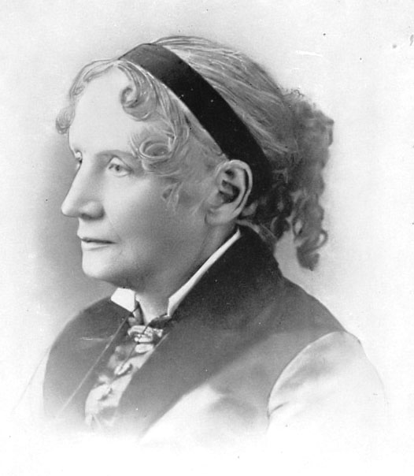
“There are worlds of money wasted, at this time of year, in getting things that nobody wants, and nobody cares for once they are got.”
Harriet Beecher Stowe - 1850

Slide 32
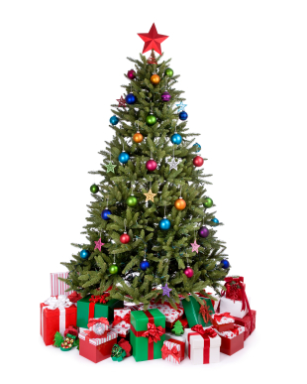
The Christmas Tree
Modern worries emerged with “domestication” –like ungrateful spoiled Children.
Christmas trees date back to the 1500s, but were only in very isolated parts of Germany.
They were a modification of the greenery traditions, popular with the Norse, who revered plants that don’t die in the winter.
In the mid 1800s, printed stories had parents
using (table top) Christmas trees to control gift
distribution, deal with selfish kids, etc.
They soon became popular (in America and
Germany, at the same time) and became their
own commodity.
And as the presents got bigger, so did the trees.
They are not religious symbols!

Slide 33
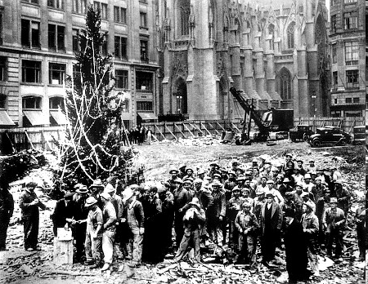
First Rockefeller Christmas tree 1933

Slide 34
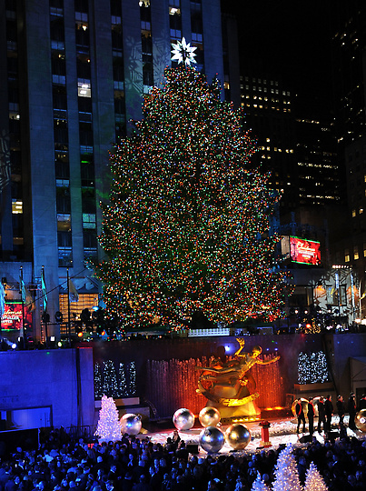
Rockefeller Christmas Tree 2011

Slide 35
Christianizing Christmas
As holiday celebrations became popular again, Christians renewed their war for Christmas, trying to claim the celebrations for their own once again as a conversion tool.
Since everyone is celebrating Christmas, if they can claim it as a Christian holiday, they make everyone a “by-proxy Christian.”
They began by instructing everyone
to “Keep Christ in Christmas,”
creating the false impression that
“the Christian Christ-centered way”
is the only appropriate way to
celebrate the holiday.
http://www.keepchristinchristmas.ca/

Slide 36
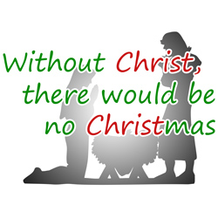
Christmas is not about Christ
They claim that Christmas must be about Christ, since “Christ” is right there in the name.
But such arguments are laughable.
The Christians are the one that started calling December celebrations by that name, over 5000 years after humanity had begun celebrating in December.
And the name of something is irrelevant to its origins or even the meaning of the word. (Sunday is not about the sun, Saturday about Saturn, Thursday about Thor, etc.)
It would be like me going to someone’s house,
calling their dog by the name “Kyle’s dog,”
and then trying to take the dog home at the
end of the night, claiming it was mine because
of what people were calling it.

Slide 37
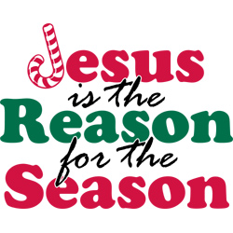
Jesus is not the reason for the season
They spread the falsehood that “Jesus is the reason for the season.” (We have seen, he clearly is not.)
This creates the false impression that every element of the holiday is either derived from Christian traditions (e.g., we give gifts because the Magi did) or a perversion of it (e.g., Santa Claus).
Christians have so convinced themselves
that this is true those who now spread
this in the church are convinced
that it is true—even the pastors don’t
know they are saying something false.
A new trend has started with Thanksgiving.

Slide 38
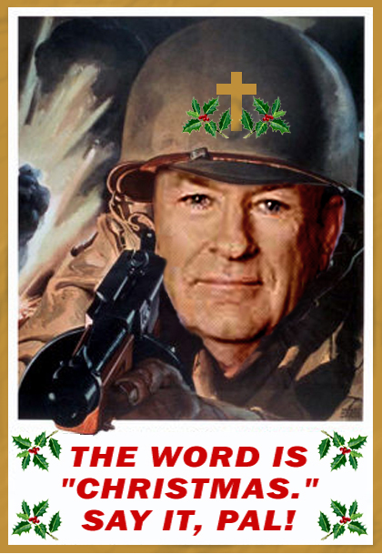
There is no War “on” Christmas.
This makes very clear the unconstitutionality of things like court house nativity scenes and religious school plays.
By promoting the religious aspects of the holiday, governments promote Christianity—a religious establishment (noun!)—by backing up the Christians in their War for Christmas.
When you put a lone nativity scene on your lawn, and nothing else, you imply that the holidays are about Jesus.
Notice the bit of Christian propaganda that is even lodged in Christian complaints about such things; liberals are waging a “war on
Christmas”—as if the Christian aspects of the holiday
that liberals don’t want the government promoting
“are Christmas.”
Of course, most of the claims about what has been
done in “the War on Christmas” are pure fiction, and at
best are exaggerations about attempts to keep Christians
from forcing their celebrations on others.
Although, I don’t think saying “Merry Christmas”
endorses Christianity anymore than worshipping on
Sunday endorses Sun-worship or taking Saturday off
endorses Saturn-worship.
So the fuss over saying “Merry Christmas” is a bit much.
But the inclusive efforts of “Happy Holidays” are laudable.

Slide 39
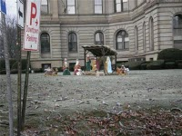
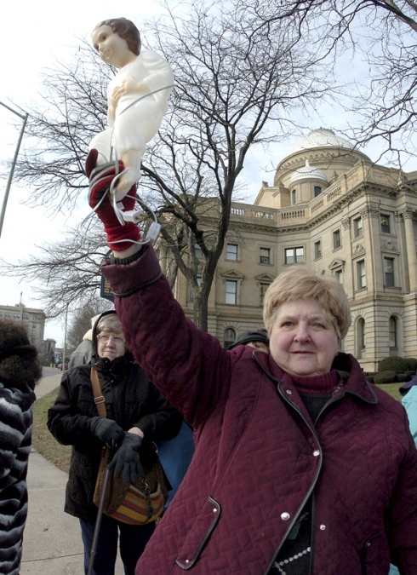
The 2009 Court House Nativity Debacle

Slide 40
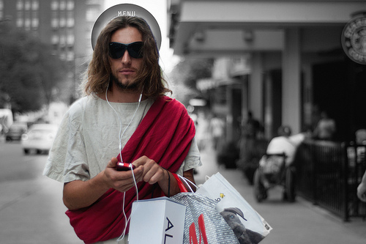
Then what is Christmas about?
If you define Christmas by our practices, then it is no more religious than Independence Day.
All the most popular Christmas songs, movies, etc., are secular.
Our entire economy is defined by 4th quarter profits from Christmas sales.
In 2005, 20% of all purchases were Christmas
purchases.
We spend most of our Christmas
opening presents and eating with family.
We spend the season feasting and drinking.
Aliens looking down at our festivities
would be surprised that we consider
it a religious holiday—or, more likely,
they would conclude that “consumerism”
was our religion and that Christmas was
our most sacred day.

Slide 41
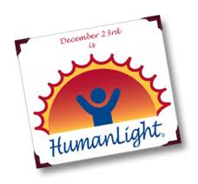
Who should celebrate the holiday?
Whoever damn well pleases!
Flynn argues that “infidels” should not celebrate because it makes us hypocrites—disapproving of Christianity, yet celebrating the birth of its savior—and helps the fundamentalist agenda because it promotes their idea that the majority is Christian because the majority celebrates Christmas.
“Look,” I can imagine Pat Buchanan saying as he spots a Christmas tree in another atheists' window, “Everyone’s Judaeo-Christian at Christmas time.” (The Trouble with Christmas, p. 234)
But not celebrating Christmas because the Christians claim it’s their holiday gives credibility to the Christian lie that the holidays belongs to them.
If Pat Buchanan told me I was a Christian because I had a Christmas tree, I wouldn’t admit defeat, slink away, and take the tree down. I’d point out that he was an idiot for thinking that a Christmas tree is a Christian symbol, or that Christmas is a Christian holiday, laugh in his face, and put up a bigger tree next year just to spite him.
Just like, if someone told me I couldn’t blow stuff up on July 4th
because “America is a Christian nation,” I would promptly correct
their historical revisionism and tell them where they could stick it.
Christmas belongs to no one, and we’d still do it even if no one
ever believed in Jesus. Not celebrating “because it’s a Christian
holiday and I’m not Christian” grants Christians a victory in the
war for Christmas that they have never even been close to
winning.

Slide 42
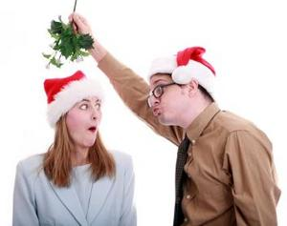
How should we celebrate?
I agree with Flynn that humanists taking seriously non-Christian superstitions (like mistletoe), or celebrating non-Christian religious holidays (Saturnalia) doesn’t make much sense.
But no one really does that; if I have mistletoe in my house, I don’t really think it really has magical fertility powers—it’s just fun.
The original motivations for celebration are gone.
We no longer worship the sun god nor feel a need to celebrate his return, nor are we nervous about the return of Spring.
But the original motivations for most holidays are long gone.
The reason we celebrate Thanksgiving has nothing to do with native Americans helping us survive. We do
it because its fun and everyone else does.
When it comes to perfectly harmless
celebrations, “it’s fun” and “everyone else is
doing it” are perfectly acceptable reasons.

Slide 43
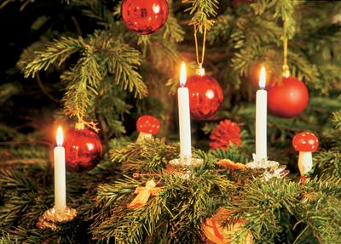
How should we celebrate?
Ah, but there is the rub—“harmless celebrations.” Is the way we celebrate Christmas “perfectly harmless?”
It used to be. In fact it serviced many social goods.
But as we have become removed from the origin of holiday traditions, and those
traditions have morphed,
some of those traditions
have become harmful.
Example: Candles in
Christmas Trees

Slide 44
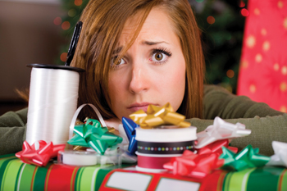
Hustle and Bustle
In an agricultural society, you need something to do in the darkest of days when there is no work to be done.
But in an industrial capitalistic society, extra obligations during the winter make no sense.
We are already too busy as it is; stacking up more obligations just wears us out.
YOU decide what YOU want to do to celebrate, and don’t let others push their expectations on you.
Make Christmas what you need it to be. Christmas doesn’t own us; we own it! It doesn’t control us; we control it.

Slide 45
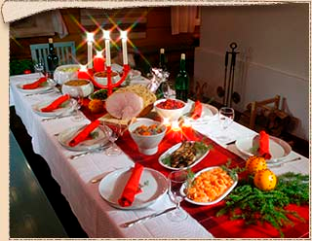
The Christmas Feast
Lavish December meals made sense in a society in which December was the time of most plentiful food, and it was difficult to store food through the winter.
In a society where almost every meal we have is equivalent to an ancient Christmas feast, an even bigger one during the time we are
less likely to work it off is
ludicrous!
The average American puts on
about one pound every Christmas,
that they never take off.

Slide 46
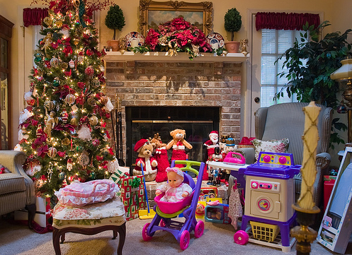
Presents!
A shoe or stocking full of fruit and nuts was a treat of unimaginable extravagance to a medieval child.
Today, kids have all they could ever want! Do they need more? It only serves to turn them into spoiled brats.

Slide 47
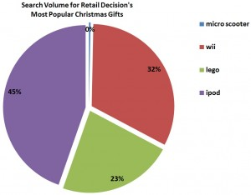
Economic Effects!
In fact, Christmas spending turns our economy upside down.
We buy luxury items—jewelry , toys, etc.—as if they were necessities.
An economy is strongest when the industries that contribute to the strength of society are strongest, and those that do not are an “afterthought”—what we do if we can afford it.
Electronics, toys and high fashion clothes made in foreign sweat shops? How about education, our infrastructure, and
social programs?
We will spend, regardless—wouldn’t it be better
to spend it on things we need, and that are
useful?
In addition, $12 billion of Christmas spending is
“Deadweight Loss.”
i.e., we spend more money than what the gifts
are worth to the recipients.
That is more than all government pork barrel
spending combined.
Note: Read Scroogenomics

Slide 49
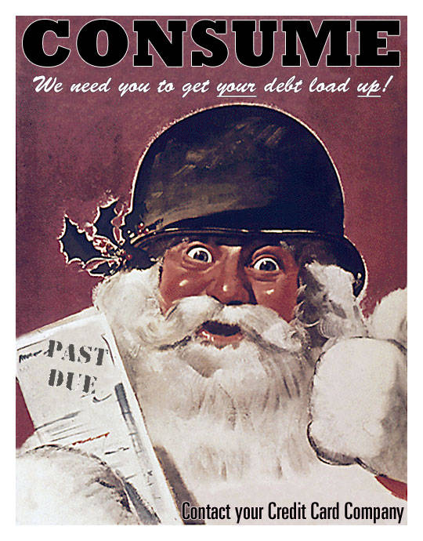
Don’t Give on Credit
We used to save up, join Christmas clubs, or put things on layaway to buy Christmas gifts.
Now, 2/3rd of Christmas spending is on credit cards.
1/3rd of that Christmas credit card spending is not paid off by February—some not until next
Christmas.
Payday, and other predatory loans,
skyrocket in January every year.
Our habit of buying things we can’t
afford just lines the pockets of those
who collect interest, but do not
produce anything of value.
Don’t buy what you can’t afford!

Slide 50
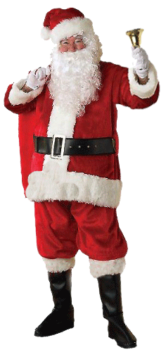
Social Inversion/Charity
Gifts of food and money to those less fortunate, along with the reversal of social roles (putting the lesser on the top)—these are the oldest of Christmas traditions.
Such traditions still make perfect sense, perhaps
now more than ever.
The Occupy Wall Street Protests have drawn
attention to the grotesquely unequal distribution
of wealth in this country.
Something similar can be said of the world wide
economy, where Americans are the top 1%.
A dollar in the hands of the poor is more valuable and
valued than a dollar in the hands of the rich.
Consider giving to charity in someone’s name as a gift.
Make a tradition of volunteering for a charity.

Slide 51
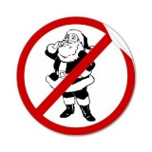
St. Nicolas/Santa Claus
I don’t think this ever made sense.
You can understand why Clement Moore, and other rich New Yorkers, invented and popularized the tradition to keep poor people out of their house.
Invite me back, and I’ll tell you the whole Santa Claus Story—
Spoiler: He’s not really St. Nicholas.
But I don’t think humanists can consistently encourage their children to believe in Santa, any more than they can encourage them to believe in Jesus.
Both demand a kind of credulity that you want to avoid in your children—again, invite me back, and I’ll elaborate.

Slide 52
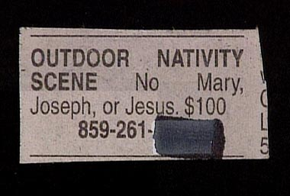
Holiday Symbols
But don’t be bothered when a Christian tries to label you a hypocrite because you have a Christmas tree, hang Christmas lights, sing Christmas carols, say “Merry Christmas” or participate in any other number of Christmas traditions.
None of these things are Christian any more than fireworks are.
In fact, I think the hubbub about Christmas trees in government ran facilities is a bit silly. Their name does not make them Christian.
As long as you don’t go to a Christian church on Christmas, or have a nativity scene in your yard—these things are exclusively Christian—I think you are in the clear.

Slide 53
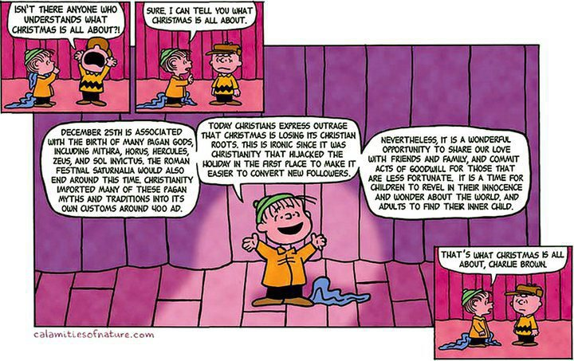

Slide 54
